Slide 1


METABLOCK - we help you navigate through the metaverse with AI
By: Rahmad, Suhardiman

Slide 2
INTRODUCTION
RAHMAD GUNAWAN
SUHARDIMAN AGUNG

Slide 3
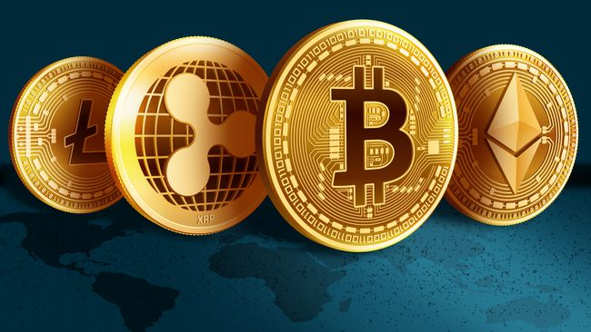
BACKGROUND
We help you manage your investment in metaverse with AI
Our app provides AI-based recommendation system to invest in metaversal tokens. Problems that we are trying to solve include:
Metaversal token has high volatility and AI may help in managing investment risk
There are hundreds of metaversal tokens in the market and it is difficult to keep track of those asset classes. AI may help in automating some of the processes and monitoring those coins
There are a high degree of frauds occurring in the metaverse. We help you select tokens that have lower risk

Slide 4
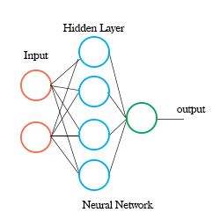
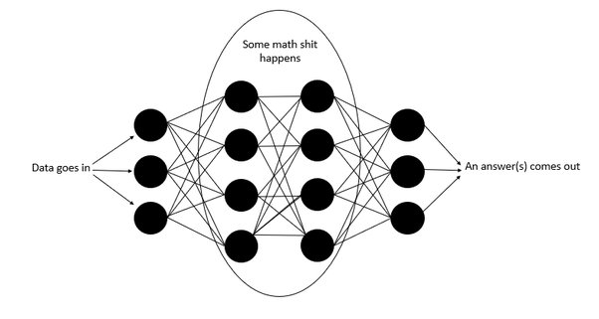
TIMELINE
Project is completed within 3 days
Day 1
Day 2
Day 3
Project ideation
Problem framing
AI modeling
Product development
Deployment

Slide 5
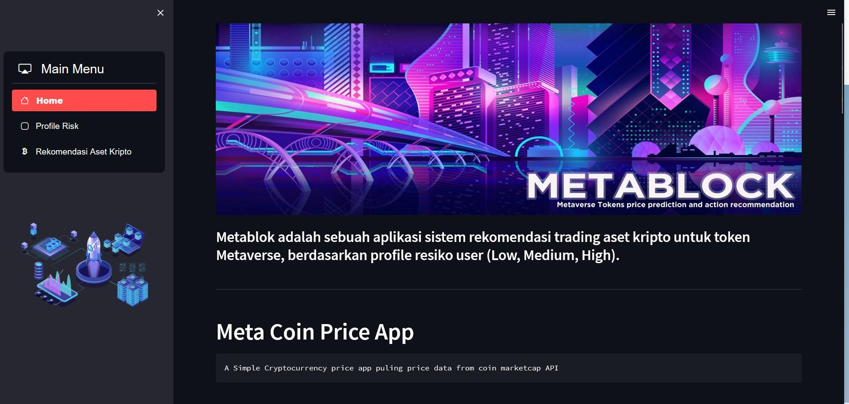
DEMO

Slide 6

CHALLENGES
Time is the biggest constraint
Price fluctuation reduces the AI’s ability to make long term prediction
Crypto asset is in the winter period with majority of the tokens’ price decreasing by 90%
We will add more functionality with more time
Factors affecting risk of crypto assets are not well documented since they are new asset classes that have been around for just a few years. As such, standard deviation is used https://www.sciencedirect.com/science/article/abs/pii/S1057521920302477

Slide 7
SUCCESS STORY
We have successfully

Slide 8
STRETCH GOAL
End-to-end trading bot may be developed in the future
Future product roadmap includes:
Automatic execution of asset purchase or sell-off, by connecting to Binance API
Periodic web scraping of news related to crypto assets, which may become a feature for the price prediction model
Include more token types - tokens in layer 1 and 2 protocols and NFT
Include dApp (decentralized app) functionality by connecting to blockchain platforms such as Ethereum with Web3.py library
Add metaversal information hub functionality
Create model for fraud risk on each token and metaverse;
Deploy on AWS
Add functionality for personal finance such as retirement planning

